Slide 2
Topic: Right-angled Triangles
EQ – What is Pythagoras Theorem and how do we use it?

Slide 3

Learning Intentions
WICOR
Students will be able to
Calculate the hypotenuse using Pythagoras Theorem

Slide 4
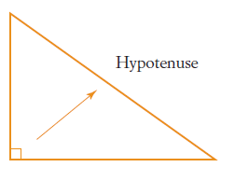
24
7
30
Right-angled Triangles
Date:
EQ – What is Pythagoras Theorem and how do we use it?
A right-angled triangle has one angle measuring 90° and two smaller angles. The side opposite the right angle is the longest side.
That is called the hypotenuse.
What is the hypotenuse?

Slide 5
Practice
c
hypotenuse
hypotenuse
c
a
b
hypotenuse
b
a
c
b
a
Which of these sides is the hypotenuse?

Slide 6
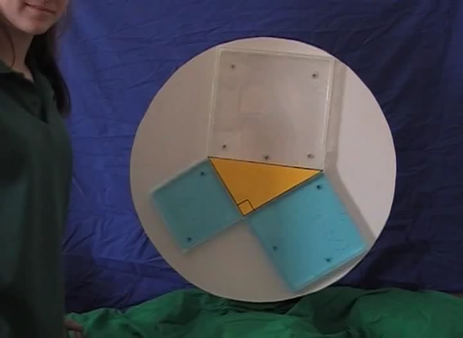

Slide 7
24
7
30
Right-angled Triangles
Date:
EQ – What is Pythagoras Theorem and how do we use it?
How to use Pythagoras’ theory to find hypotenuse?
c² = a² + b²
Square both the non-hypotenuse (shorter sides) sides
Add the results together
Square root your answer to find the length of the hypotenuse
If you need extra help view this YouTube clip:
https://www.youtube.com/watch?v=WqhlG3Vakw8&t=13s

Slide 8
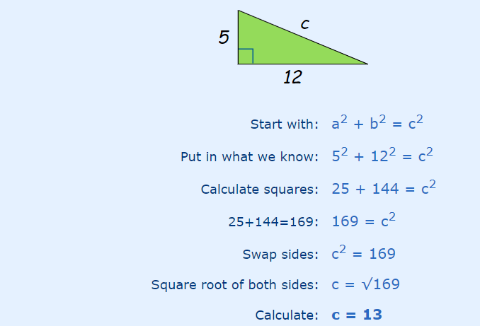
24
7
30
Right-angled Triangles
Date:
EQ – What is Pythagoras Theorem and how do we use it?
EXAMPLE
How to use Pythagoras’ theory to find hypotenuse?
Find the length of “c” in this triangle

Slide 9
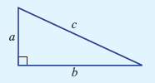
Summarise
a² + b² = c²
shorter sides longer side (hypotenuse)

Slide 10



Practice
Find the length of the hypotenuse for these:
a) b)

Slide 11
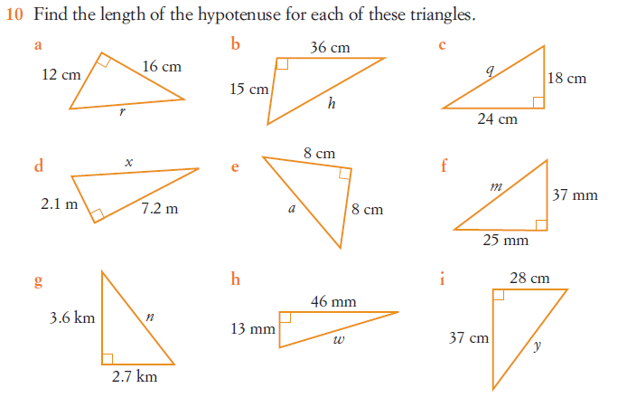
Task

